Slide 1


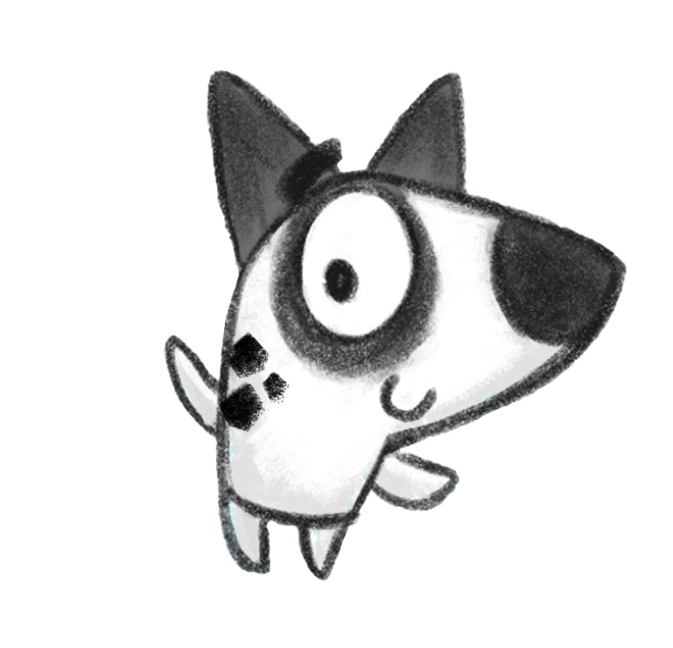




Notes:
Please customise, add or remove slides and information to reflect how the Summer Reading Challenge is run locally.

Slide 2

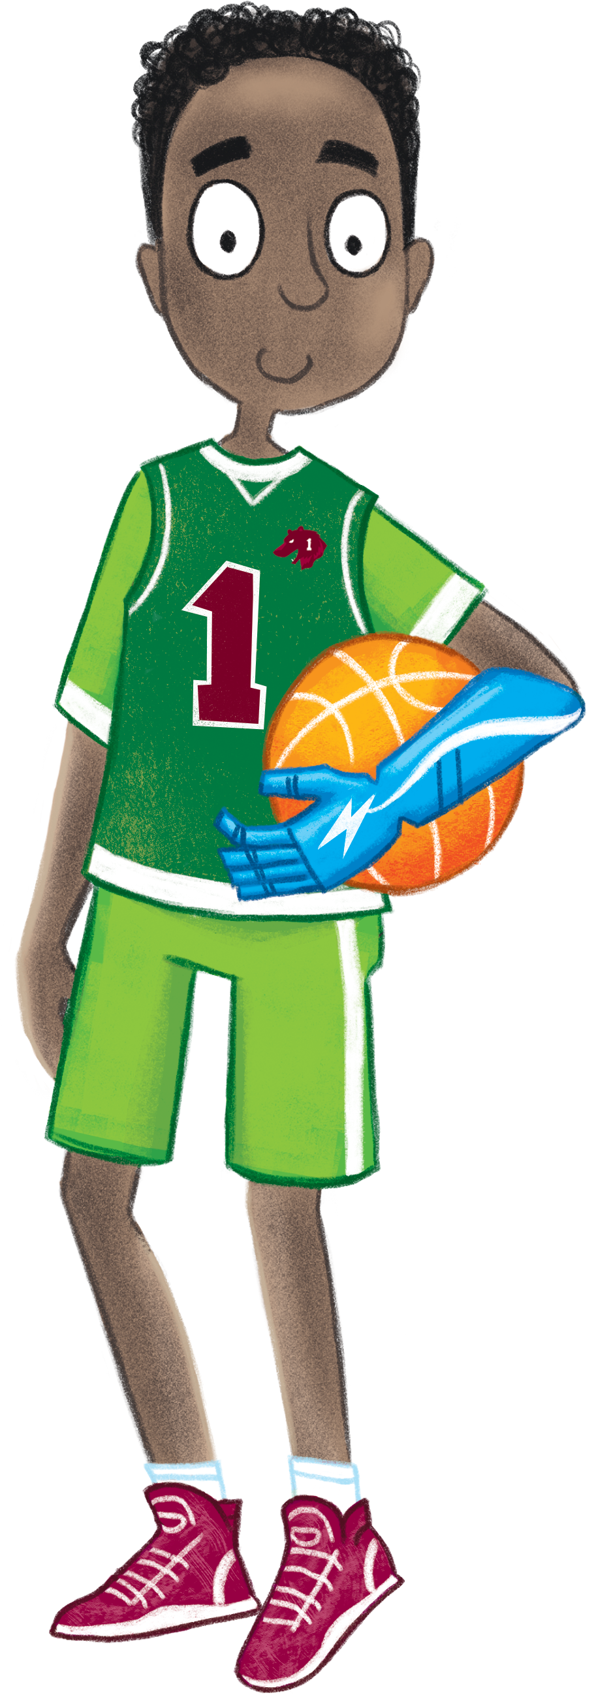
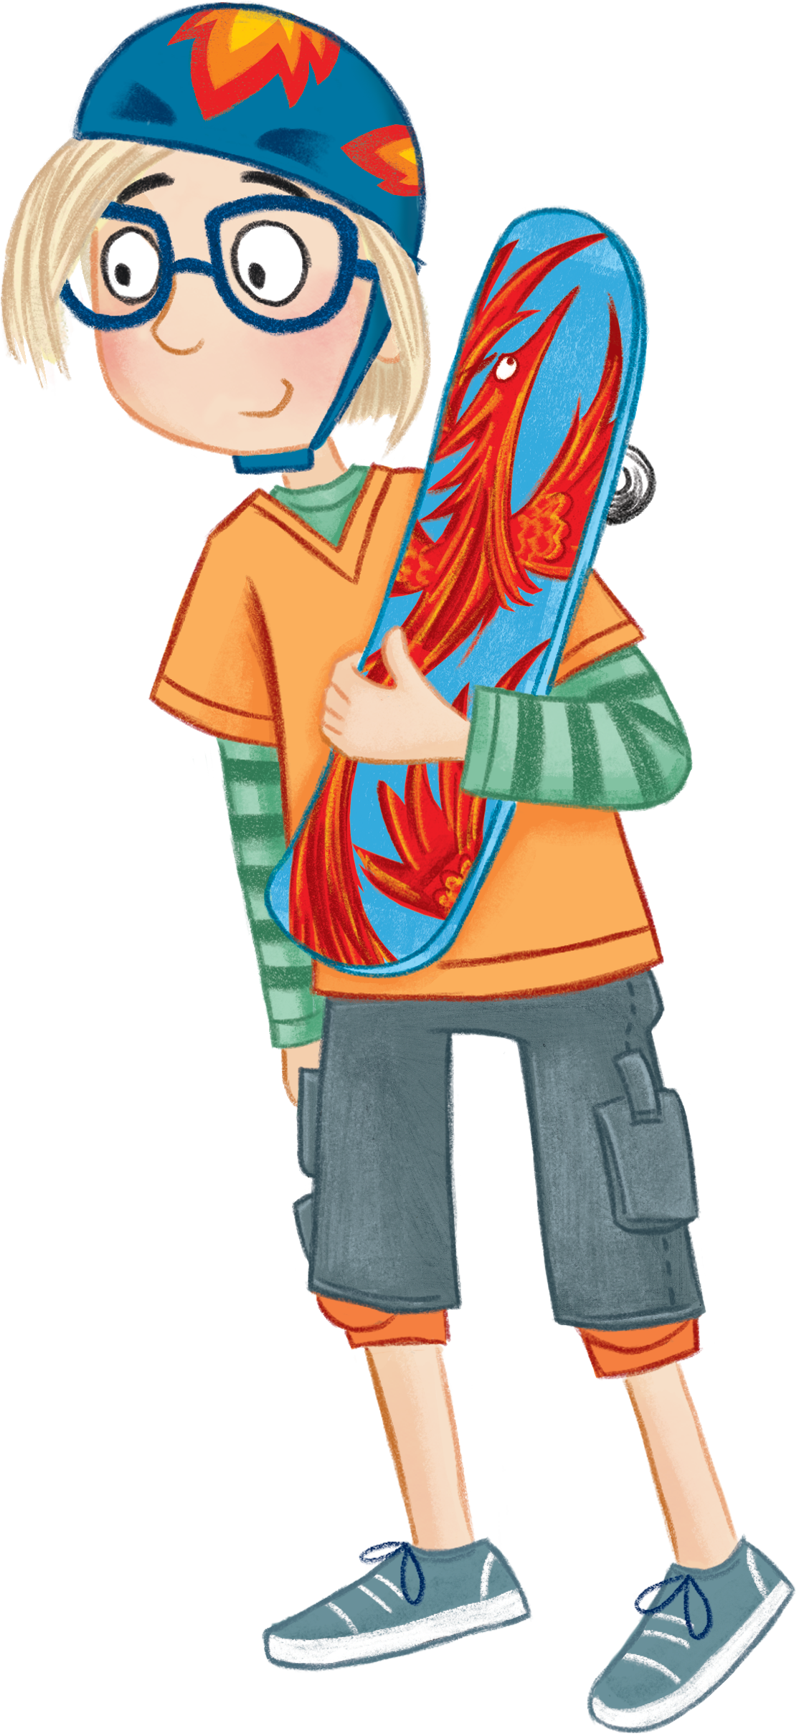
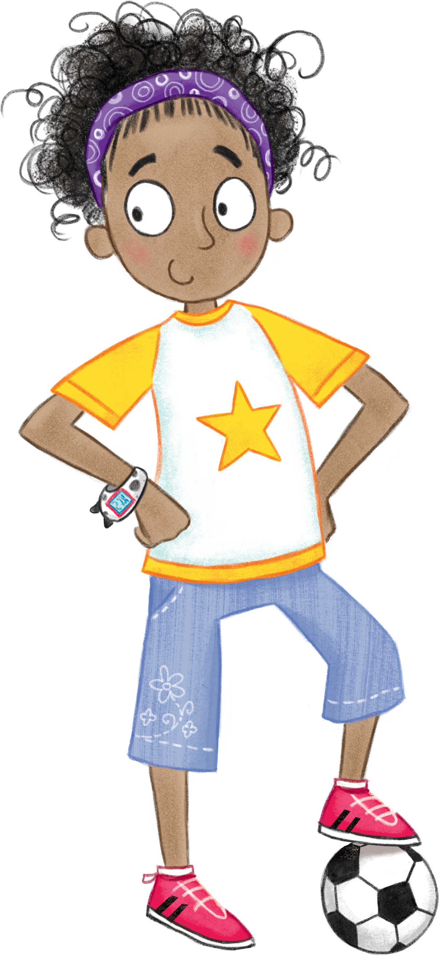
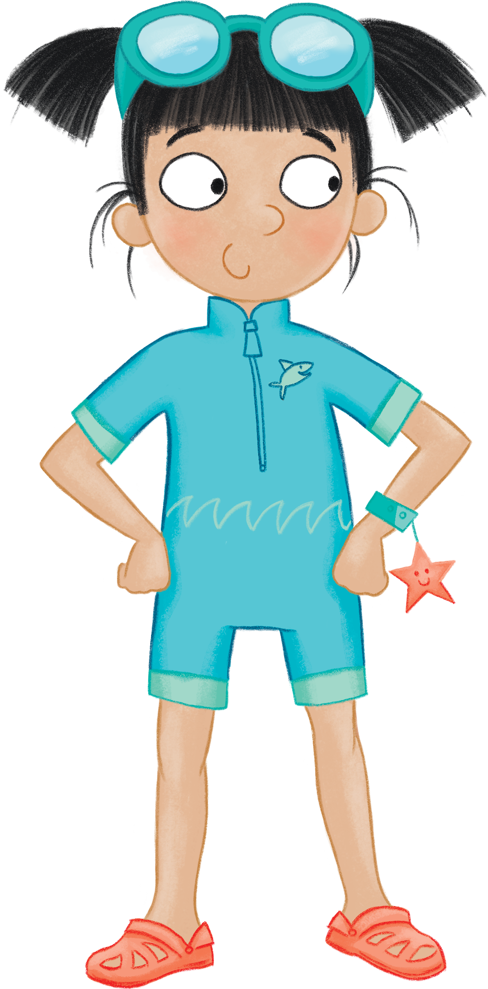
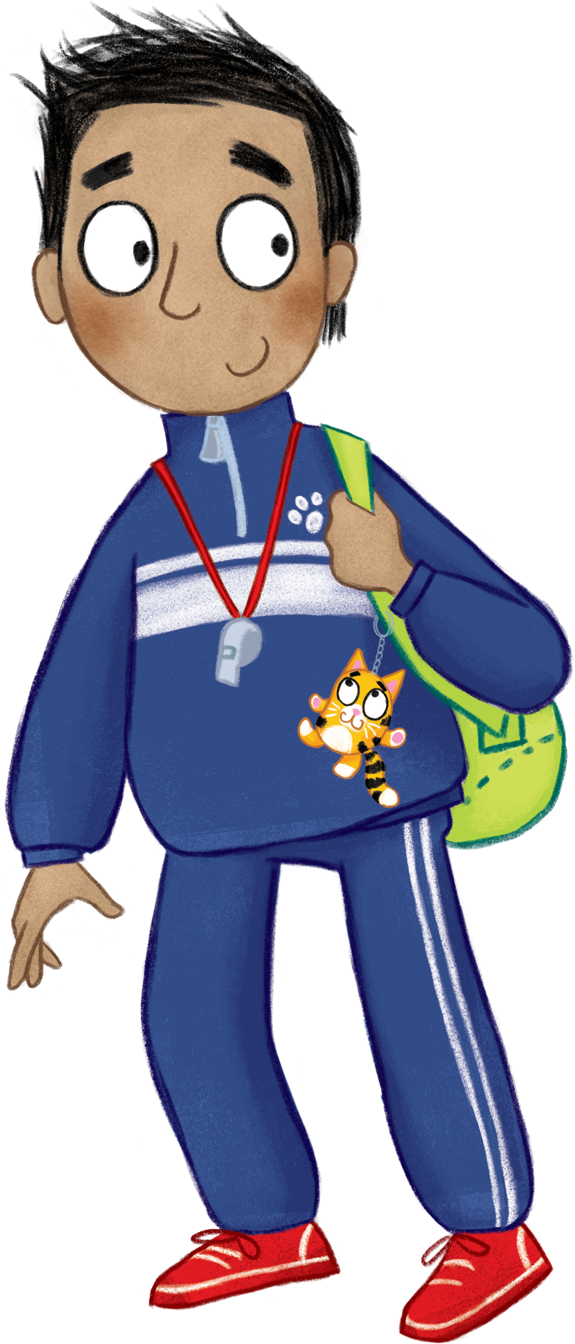
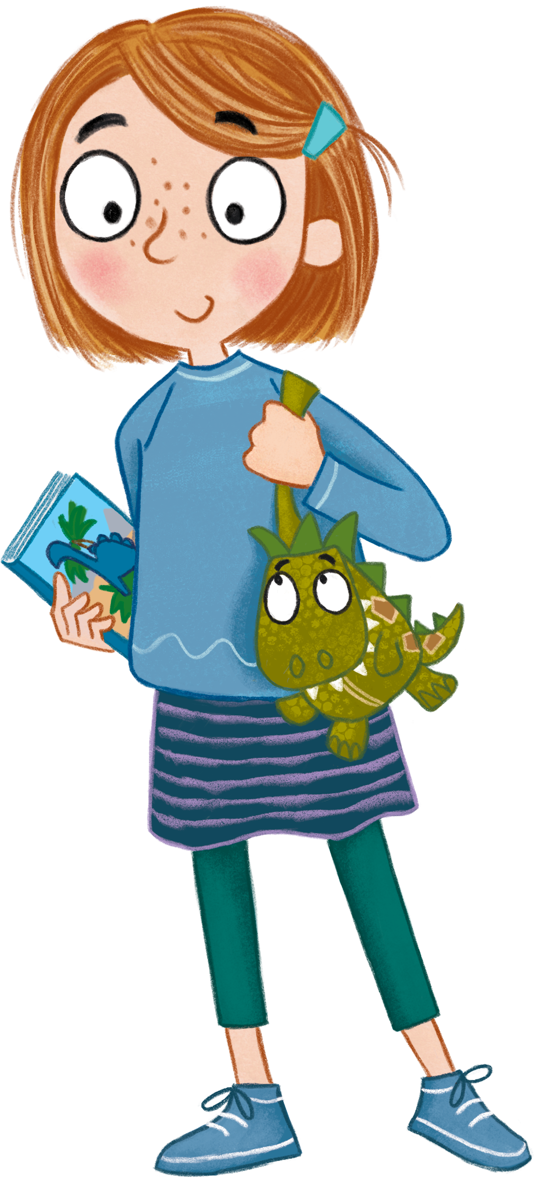
Notes:
Meet your team and their animal mascots! Naveen, Naomi, Noah, Ollie, Alesha, Sophia
Join them as they use their skills to weave their way through a summer obstacle course. Developed in collaboration with the Youth Sport Trust, the 2023 Summer Reading Challenge will celebrate play and participation, encouraging children to engage in reading, games and sports in any way that best suits them.

Slide 3


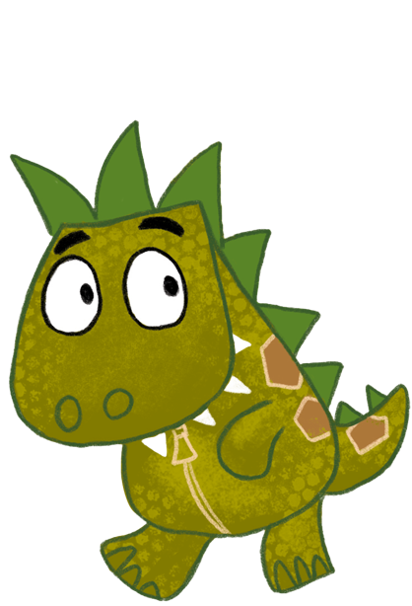
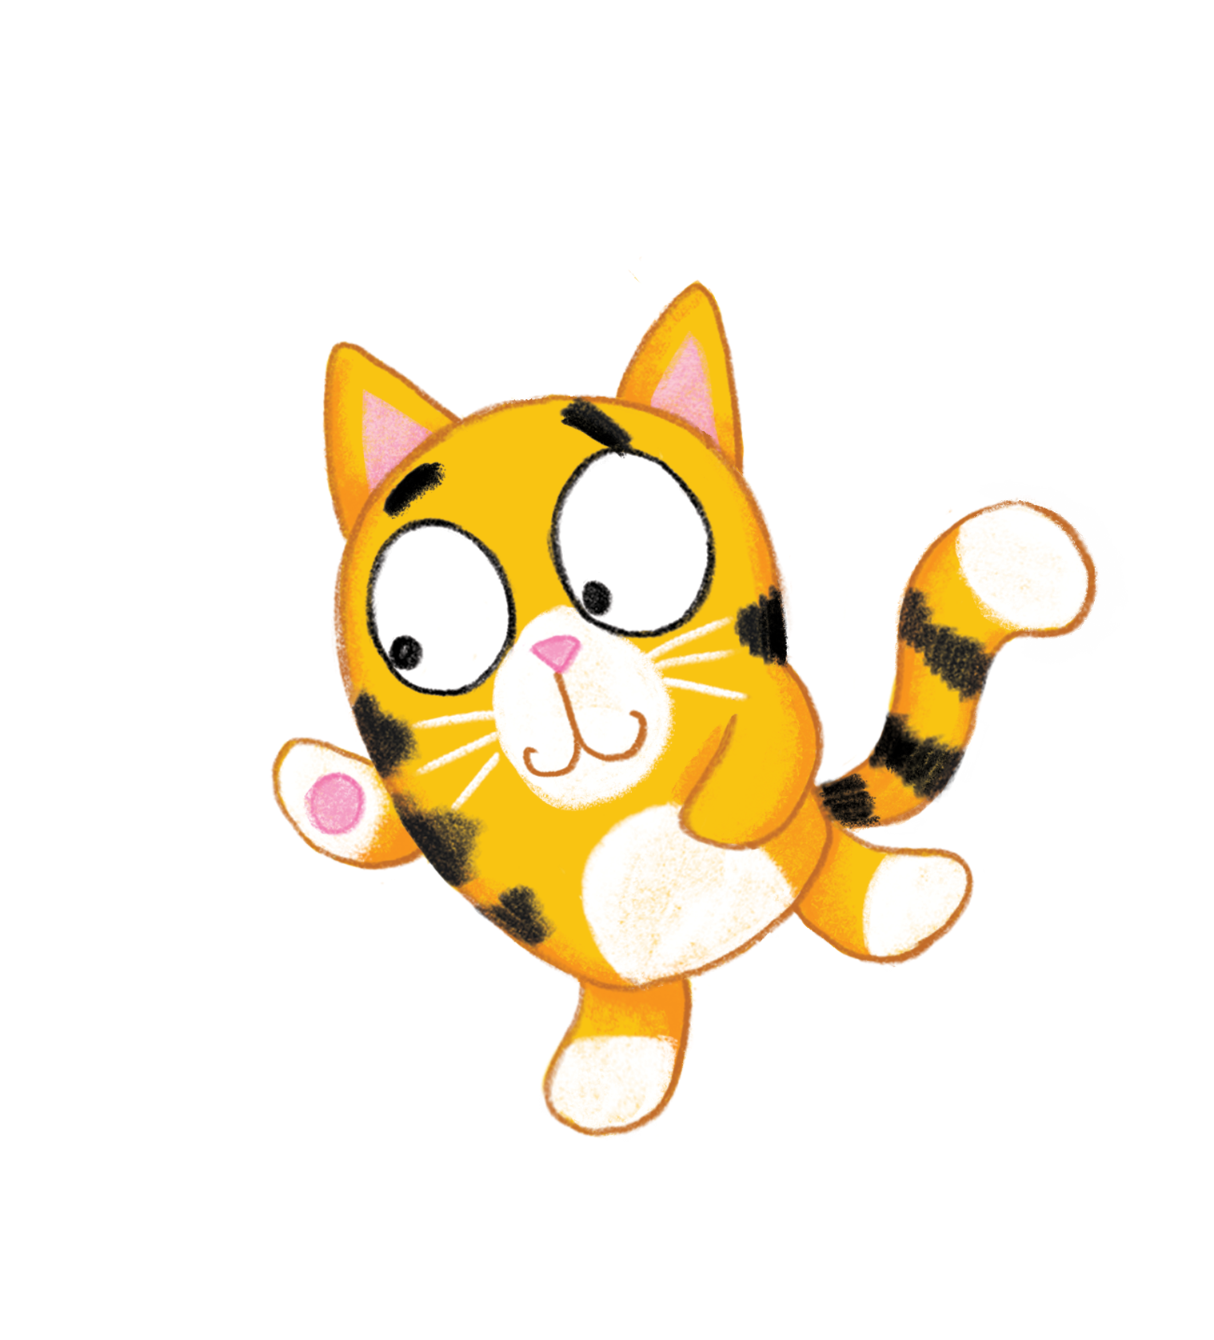

Notes:
Ready, Set, Read! will showcase how reading can be active and engaged, and can itself involve teamwork and community.
You'll receive a special core pack when you join the Summer Reading Challenge at the library.
In this fun collector's folder you can try and spot Naveen's cat Cosmo, Naomi's starfish pal Shelley, and Noah's bear mascot Bruno. Join Sophia's dino Doug, Alesha's dog Dynamo, and Ollie's phoenix Blaze in working towards the final leap to be a reading champion!

Slide 4



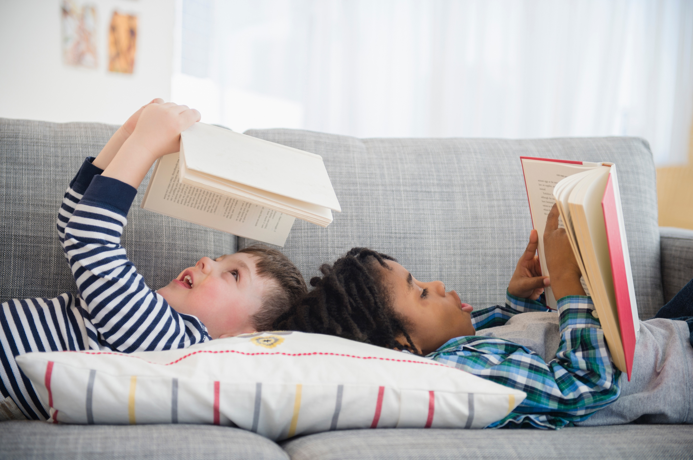
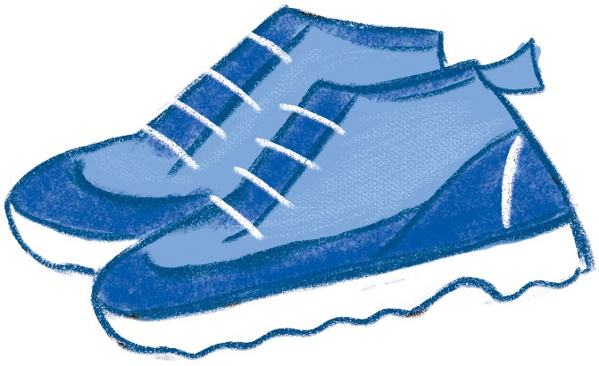
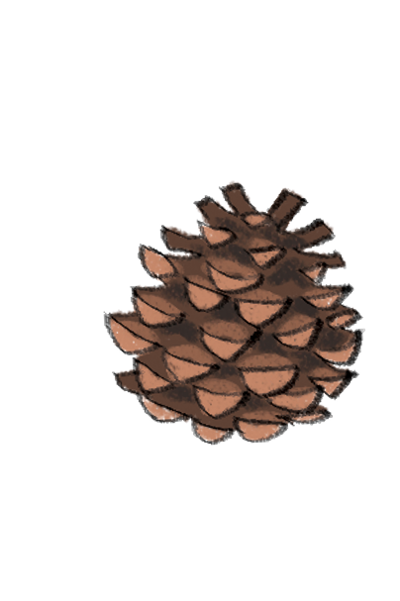
Ewch i’ch llyfrgell yr haf yma i ymuno â’r Sialens AM DDIM!
Cofrestrwch i dderbyn eich ffolder gasglu ar gyfer Ar eich marciau, Darllenwch
Dewiswch lyfrau i’w darllen yn ystod y gwyliau
Casglwch sticeri am bob llyfr a ddarllenwch
Rhowch y sticeri ar eich ffolder i gwblhau’r Sialens!
Fe gewch chi Becyn Craidd arbennig
Image from Microsoft 365 2023

Slide 5



Cwblhewch y Sialens ac fe gewch chi eich
tystysgrif eich hun
Notes:
Most library authorities will also give medals to children who complete the Challenge, but not all. Please check with your local library service. ​
Please feel free to talk about other incentives offered by your local library service.
[Please ensure this slide reflects the rewards/incentives offered by your local library service in 2023]

Slide 6
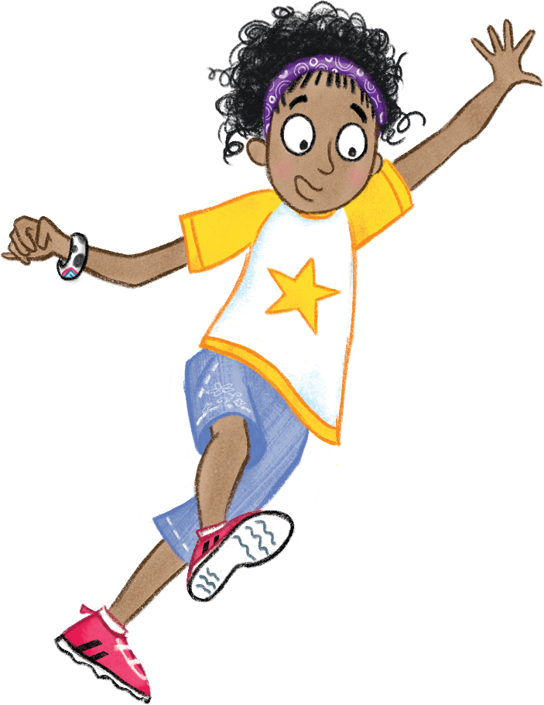



Mae’r Sialens yn dechrau…
ddydd Sadwrn 8 Gorffennaf
(yng Nghymru a Lloegr)
Notes:
Ready, Set, Read! will begin in libraries across Scotland on Saturday 24 June, and in libraries across England and Wales on Saturday 8 July.
[Please edit to reflect your local start/finish dates and include any information on launch events and summer activities]

Slide 7
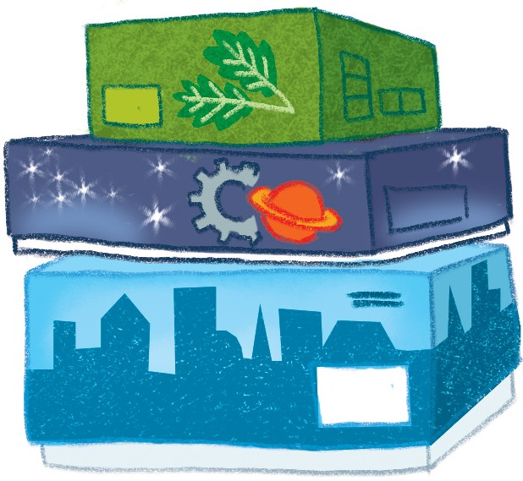
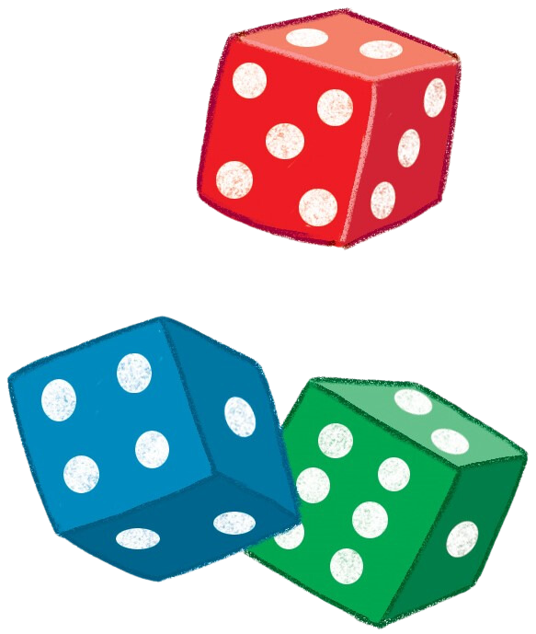



Ymwelwch â’r wefan
sialensddarllenyrhaf.org.uk
Gosodwch eich nod eich hun ar gyfer darllen yn yr haf
Sgoriwch ac adolygwch eich llyfrau i ddatgloi bathodynnau
Chwaraewch gemau a chymerwch ran mewn cystadlaethau
Rhowch i mewn y codau sydd wedi’u printio ar eich sticeri i ddatgloi gwobrau ychwanegol
Defnyddiwch y Llwythwr Llyfrau i ddod o hyd i lyfrau sydd wedi’u hargymell gan blant eraill
Notes:
The fun continues at home too! Visit the Summer Reading Challenge website to play games, review your latest reads and enter competitions.
You can share your favourite books with other children taking part in the Challenge and unlock extra rewards for your reading and reviewing!

Slide 8

Fe welwn ni chi
yn y llyfrgell!

